Slide 1

November 14, 2021
CONFIDENTIAL | © 2021 EPAM Systems, Inc.

Slide 2
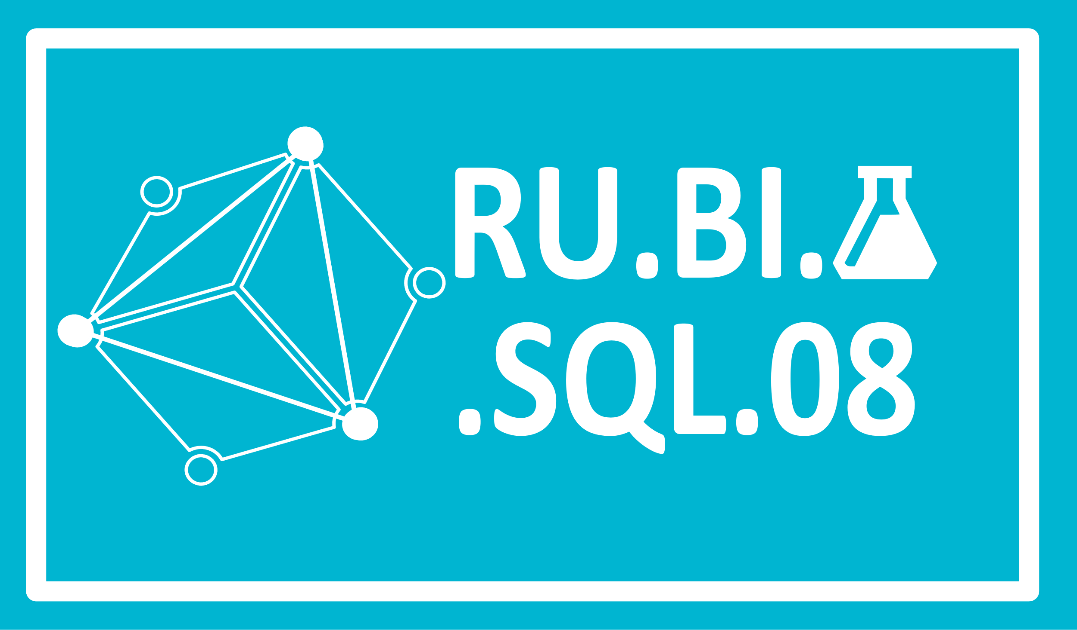
Agenda Part 1
1
Implementing Indexes and Statistics
2
Query Optimizer
3
Using Tools to Analyze Query Performance
4
Execution Plans

Slide 3
Agenda Part 2
1
Common BI solution architecture
2
Designing and Implementing a Data Warehouse
3
Designing Dimensions
4
Designing Fact Tables

Slide 4
Implementing Indexes and Statistics

Slide 5
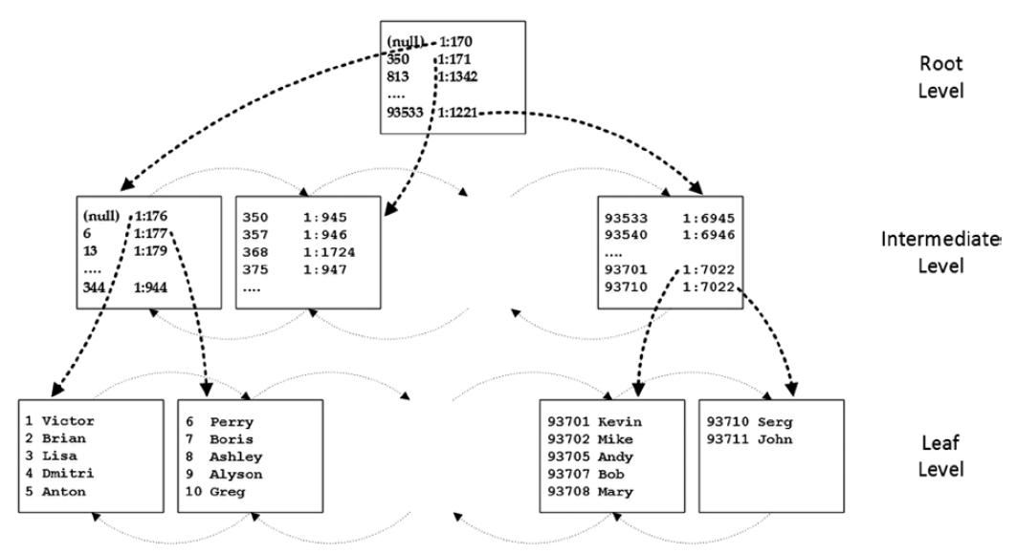
Implementing Indexes and Statistics
Clustered Indexes

Slide 6
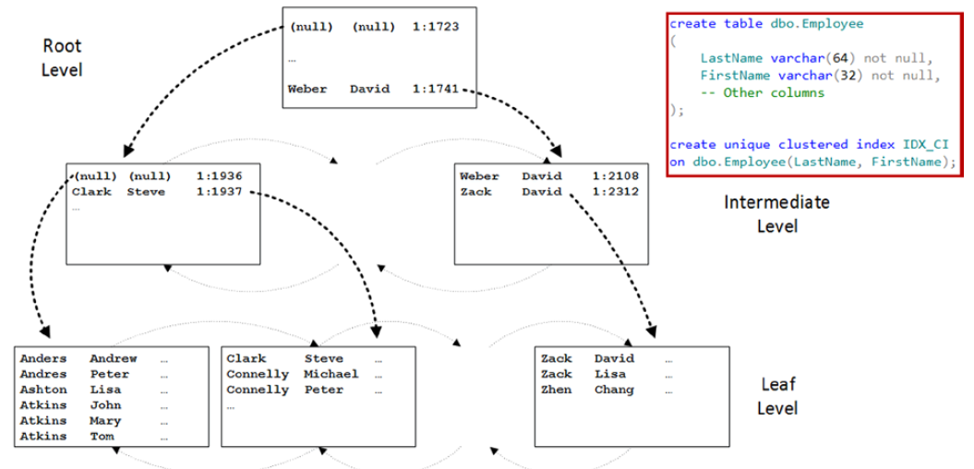
Implementing Indexes and Statistics
Composite Indexes

Slide 7
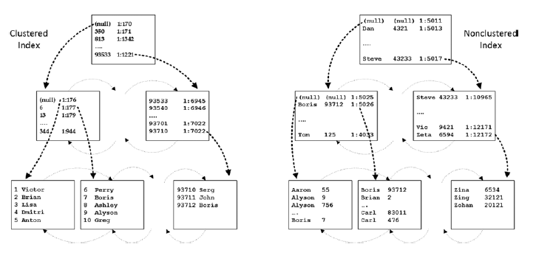
Implementing Indexes and Statistics
Nonclustered Indexes

Slide 8
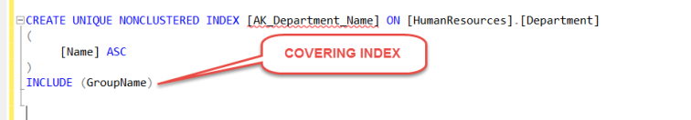
Implementing Indexes and Statistics
Covering Indexes

Slide 9
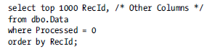
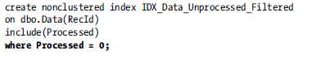
Implementing Indexes and Statistics
Filtered Indexes

Slide 10

Implementing Indexes and Statistics
Supporting Queries with Indexes
WHERE
JOIN
ORDER BY
GROUP BY
SARG

Slide 11
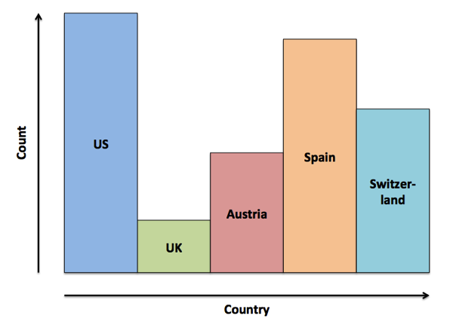
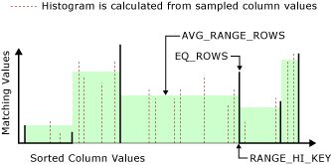
Implementing Indexes and Statistics
Statistics

Slide 12
Implementing Indexes and Statistics
DEMO

Slide 13
Query Optimizer

Slide 14
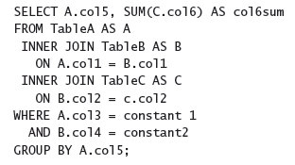
Query Optimizer
Query Optimization Problems

Slide 15
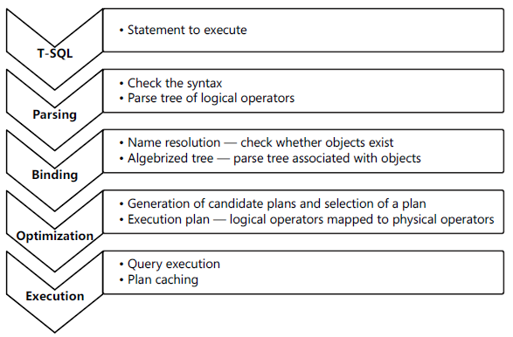
Query Optimizer
Query execution phases

Slide 16
Query Optimizer
Parameter Sniffing
DEMO

Slide 17
Using Tools to Analyze Query Performance

Slide 18
Using Tools to Analyze Query Performance
SQL Server Extended Events
Events These are your points of interest for monitoring. You can use events for monitoring or to trigger synchronous or asynchronous actions.
Targets These are event consumers. You can use targets that write to a file, store event data in a memory buffer, or aggregate event data. Targets can process data synchronously or asynchronously.
Actions These are responses to an event. They are bound to an event. Actions can capture a stack dump and inspect data, store information in a local variable, aggregate event data, or even append data to event data. For example, in SQL Server, you can use the execution plan detection action to detect execution plans.
Predicates These are sets of logical rules to filter captured events. In order to minimize the impact of a monitoring session on your system, it is important that you capture only events you need.
Types These help interpret the data collected. The data is actually a collection of bytes, and types give this data context. A type is provided for events, actions, targets, predicates, and types themselves.
Maps These are SQL Server internal tables that map internal numeric values to meaningful strings.

Slide 19
Using Tools to Analyze Query Performance
SQL Server Profiler
Event An event is an action within SQL Server. For example, an action can be a logon failure, T-SQL batch, start of a stored procedure, and more.
EventClass This is the type of an event. The event class defines the data that an event can report.
EventCategory Event categories define groupings of events
DataColumn A data column is an attribute of an event. If you save a trace to a table, an event is represented by a row in the table, and attributes of events are columns in the table.
Template A template is a saved trace definition. SQL Server Profiler comes with a couple of predefined templates that can speed up the creation of a trace.
Filter Filters limit the events traced. You can put a filter on any event column. In order to minimize the impact of monitoring on your SQL Server instance, you should filter out any event you do not need in your current trace.
Trace A trace is a collection of events, columns, filters, and data returned

Slide 20
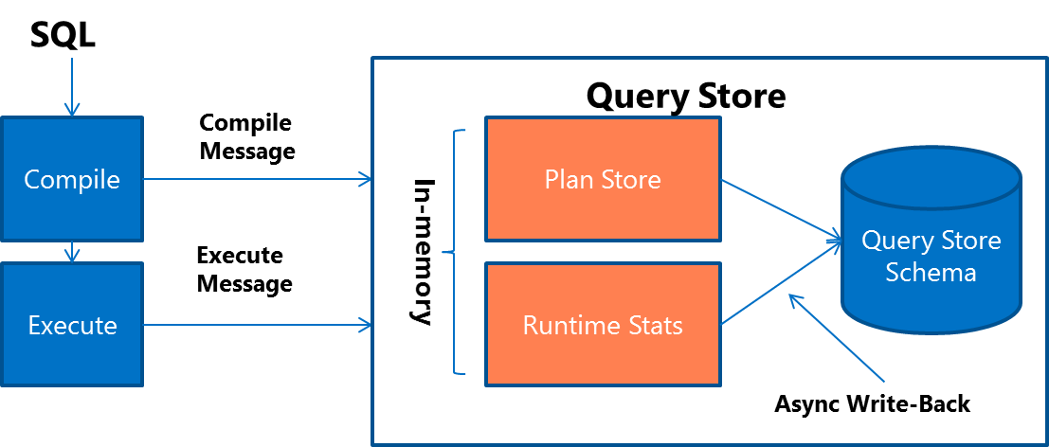
Using Tools to Analyze Query Performance
Query Store

Slide 21
Using Tools to Analyze Query Performance
SET STATISTICS IO ON;
Scan count
Logical reads
Physical reads
Read-ahead reads
Lob logical reads
Lob physical reads
Lob read-ahead reads

Slide 22
Using Tools to Analyze Query Performance
SET STATISTICS TIME ON;
Parse and compile time
Execution time

Slide 23
Using Tools to Analyze Query Performance
Dynamic Management Objects (DMO)
SQL Server Operating System (SQLOS)–related DMOs
sys.dm_os_waiting_tasks
sys.dm_exec_sessions
Execution-related DMOs
sys.dm_exec_requests
sys.dm_exec_sql_text
sys.dm_exec_query_stats
Index-related DMOs
sys.dm_db_missing_index_details

Slide 24
Using Tools to Analyze Query Performance
DEMO

Slide 25
Execution Plans

Slide 26
Execution Plans
Execution Plan Types
Estimated plans
Actual plans

Slide 27
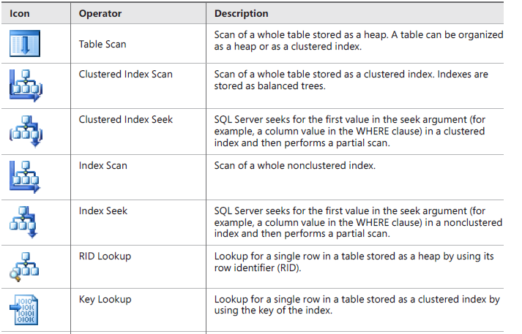
Execution Plans
Operators

Slide 28
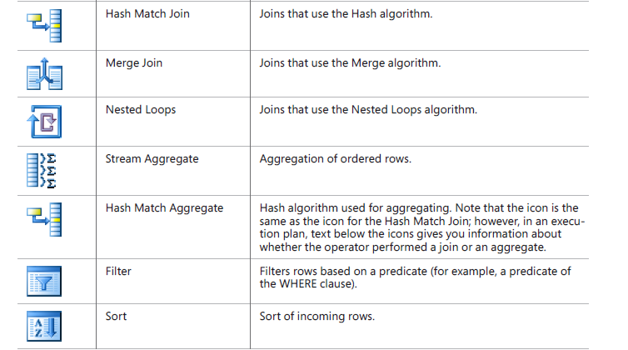
Execution Plans
Operators

Slide 29
Execution Plans
Physical Join Types
Nested Loops
Merge
Hash
Bitmap Filtering Optimized Hash (also called Star join optimization)
Adaptive join (SQL 2017)

Slide 30
Execution Plans
DEMO

Slide 31
Common BI solution architecture

Slide 32








Common BI solution architecture
Why BI?
What happened?
What is happening?
Why did it happen?
What will happen?
What do I want to happen?
Past
Present
Future
Data
ERP
CRM
SCM
3Pty
Black books

Slide 33
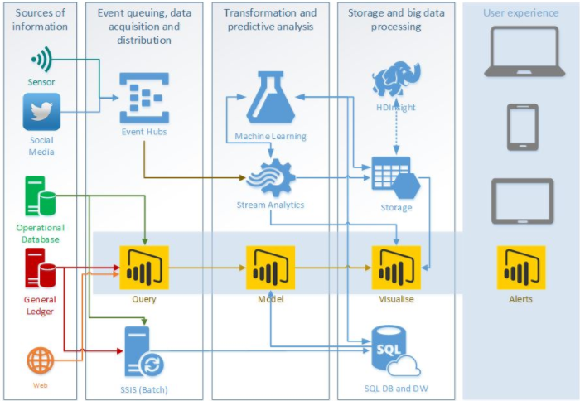
Common BI solution architecture
MS BI Architecture

Slide 34
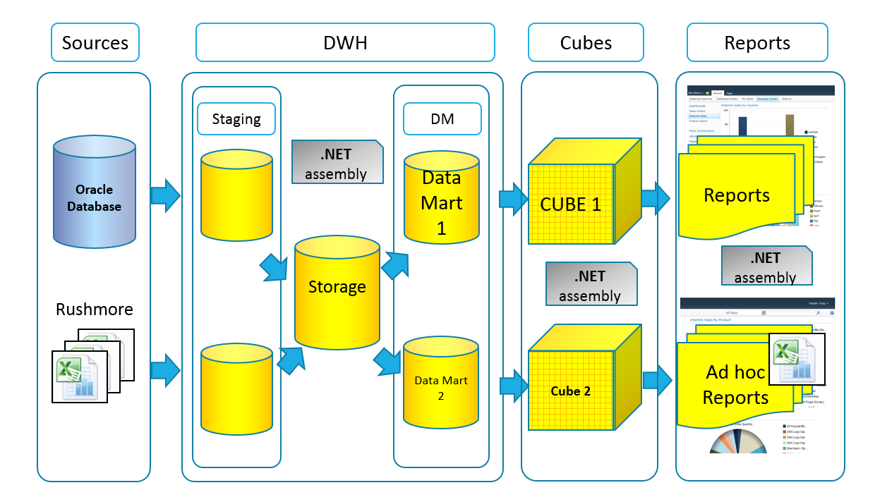
Common BI solution architecture

Slide 35
Designing and Implementing a Data Warehouse

Slide 36
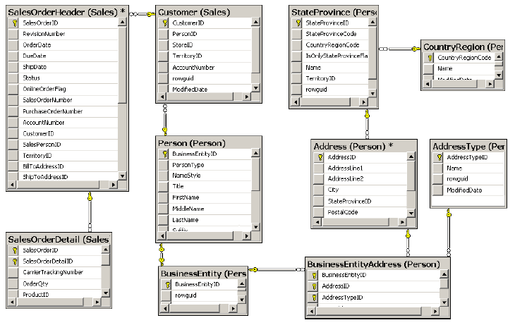
Designing and Implementing a Data Warehouse
Reporting Problems with a Normalized Schema
Comprehensive schema
Performance issues
Concurrency issues
LookUp table for Dates
Data Quality problem

Slide 37
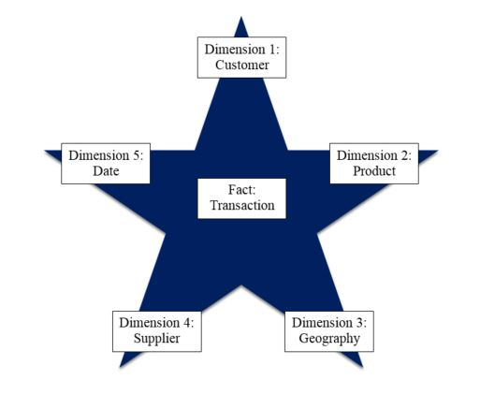
Designing and Implementing a Data Warehouse
Star Schema

Slide 38
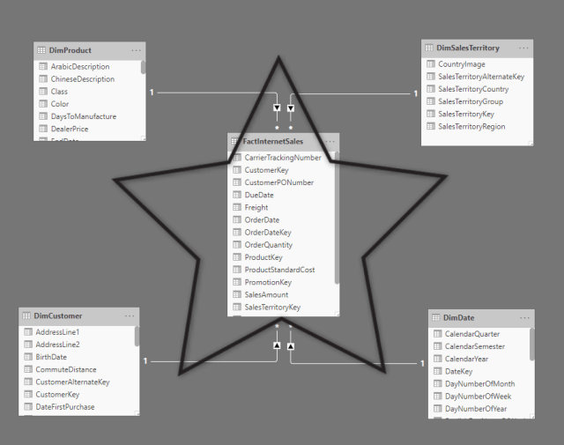
Designing and Implementing a Data Warehouse
Star Schema

Slide 39
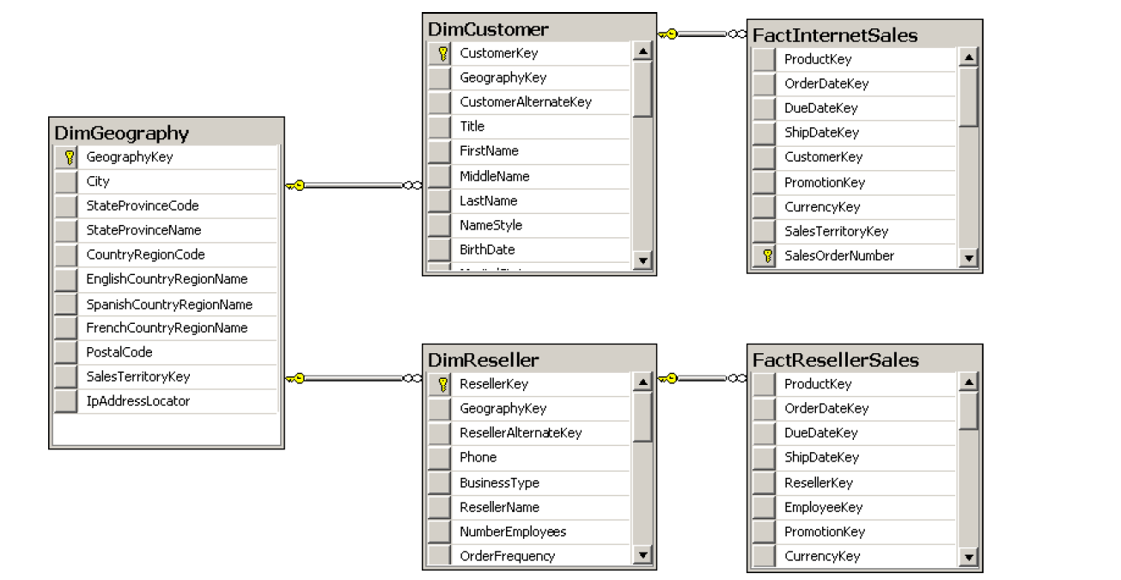
Designing and Implementing a Data Warehouse
Snowflake Schema

Slide 40
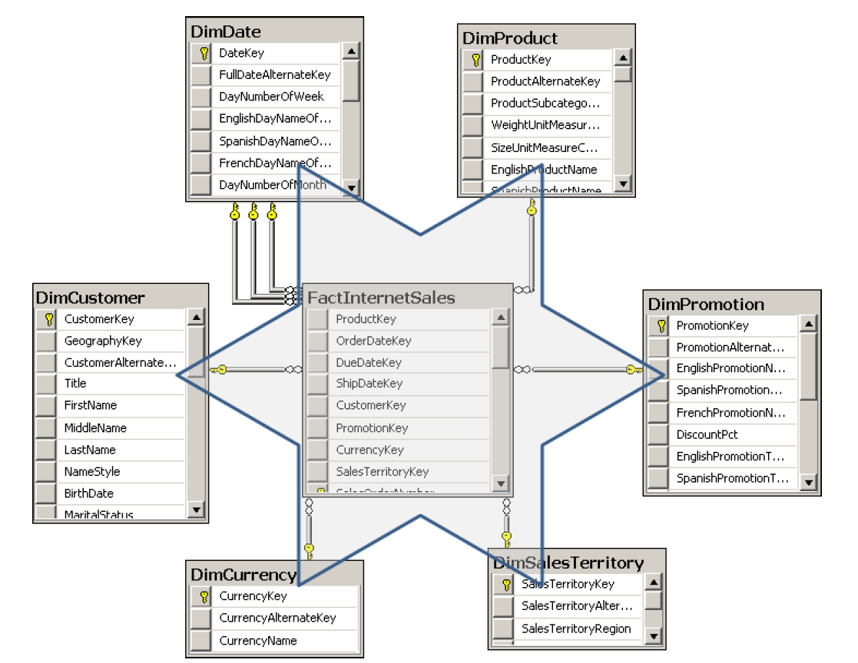
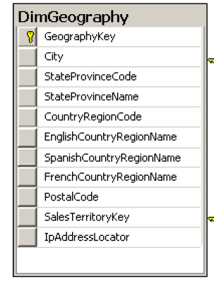
Designing and Implementing a Data Warehouse
Snowflake Schema

Slide 41
Designing and Implementing a Data Warehouse
Granularity Level
Notes:
Granularity Level
The number of dimensions connected with a fact table defines the level of granularity of
analysis you can get. For example, if no products dimension is connected to a sales fact table,
you cannot get a report at the product level—you could get a report for sales for all products
only. This kind of granularity is also called the dimensionality of a Star schema.
But there is another kind of granularity, which lets you know what level of information
a dimension foreign key represents in a fact table. Different fact tables can have different
granularity in a connection to the same dimension. This is very typical in budgeting and planning
scenarios. For example, you do not plan that customer A will come on date B to store C
and buy product D for amount E. Instead, you plan on a higher level—you might plan to sell
amount E of products C in quarter B in all stores in that region to all customers in that region.
Figure 1-7 shows an example of a fact table that uses a higher level of granularity than the
fact tables introduced so far.

Slide 42
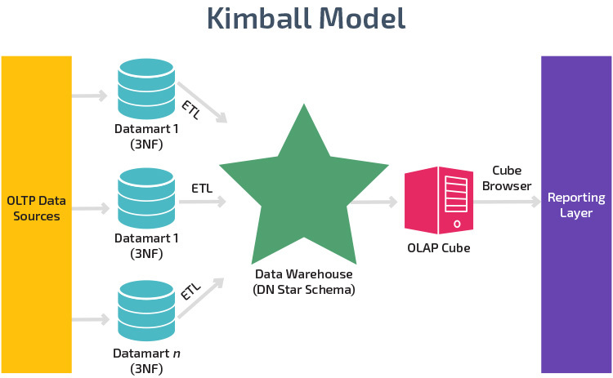
Designing and Implementing a Data Warehouse

Slide 43
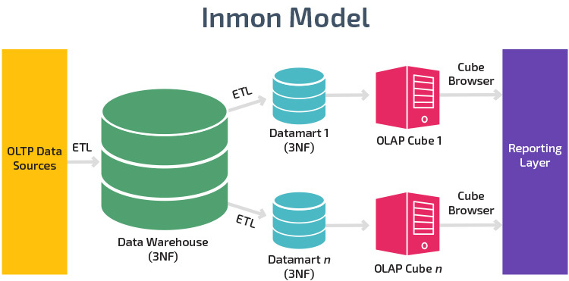
Designing and Implementing a Data Warehouse

Slide 44
Best SQL Practices for Data Warehousing

Slide 45
Best SQL Practices for Data Warehousing
Important Aspects
Avoid using constraints
Use indexes carefully
Manage statistics
Follow transaction log (use Simple recovery model on-premises)

Slide 46
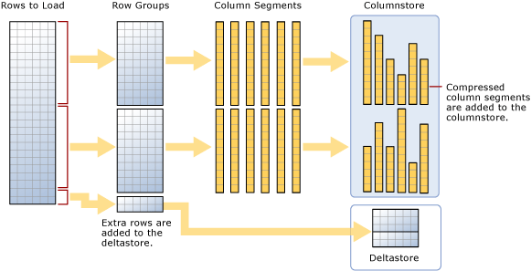
Best SQL Practices for Data Warehousing
Columnstore index

Slide 47
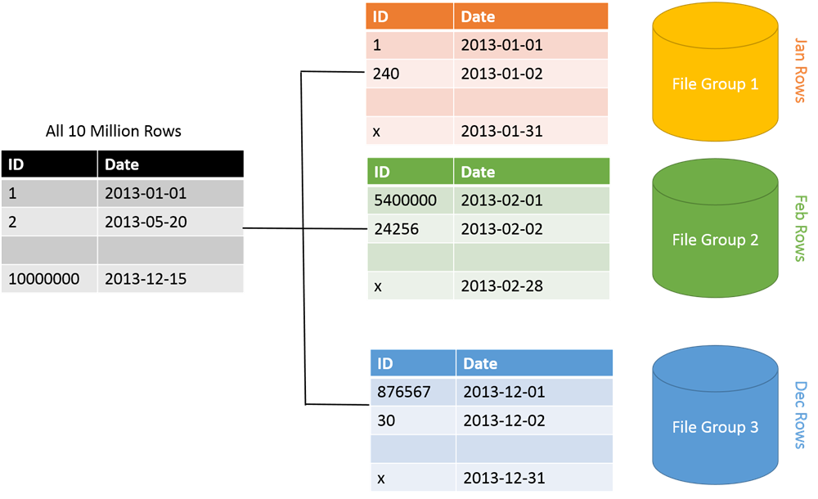
Best SQL Practices for Data Warehousing
Partition Table

Slide 48
Designing Dimensions

Slide 49
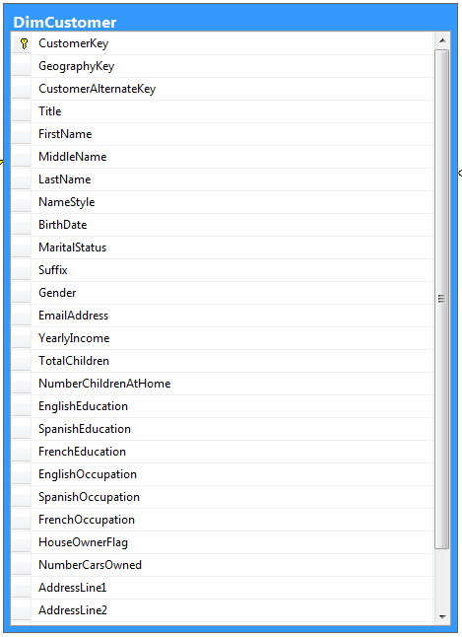
Designing Dimensions
Dimension Column Types
Keys
Used to identify entities
Name columns
Used for human names of entities
Attributes
Used for pivoting in analyses
Member properties
Used for labels in a report
Lineage columns
Used for auditing, and never exposed to end users

Slide 50
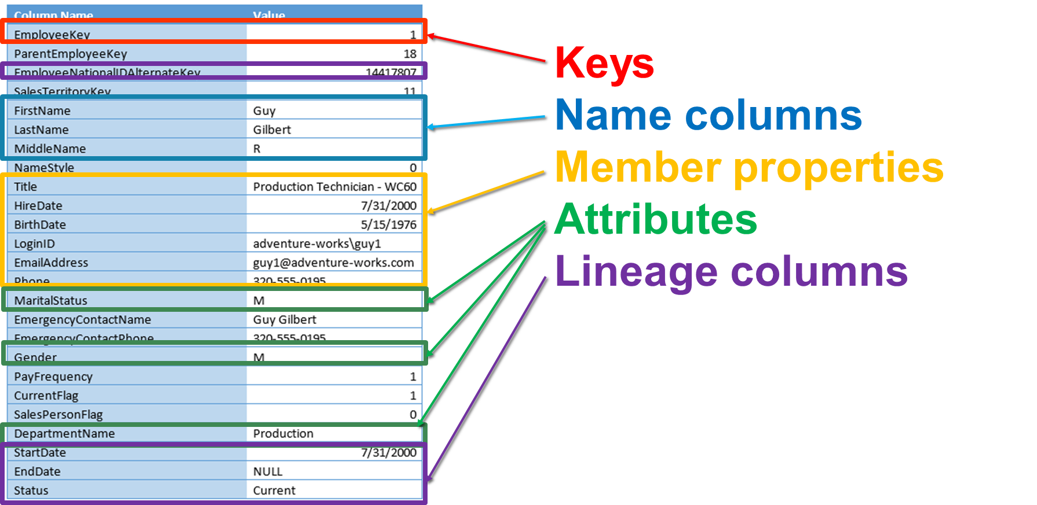
Designing Dimensions

Slide 51
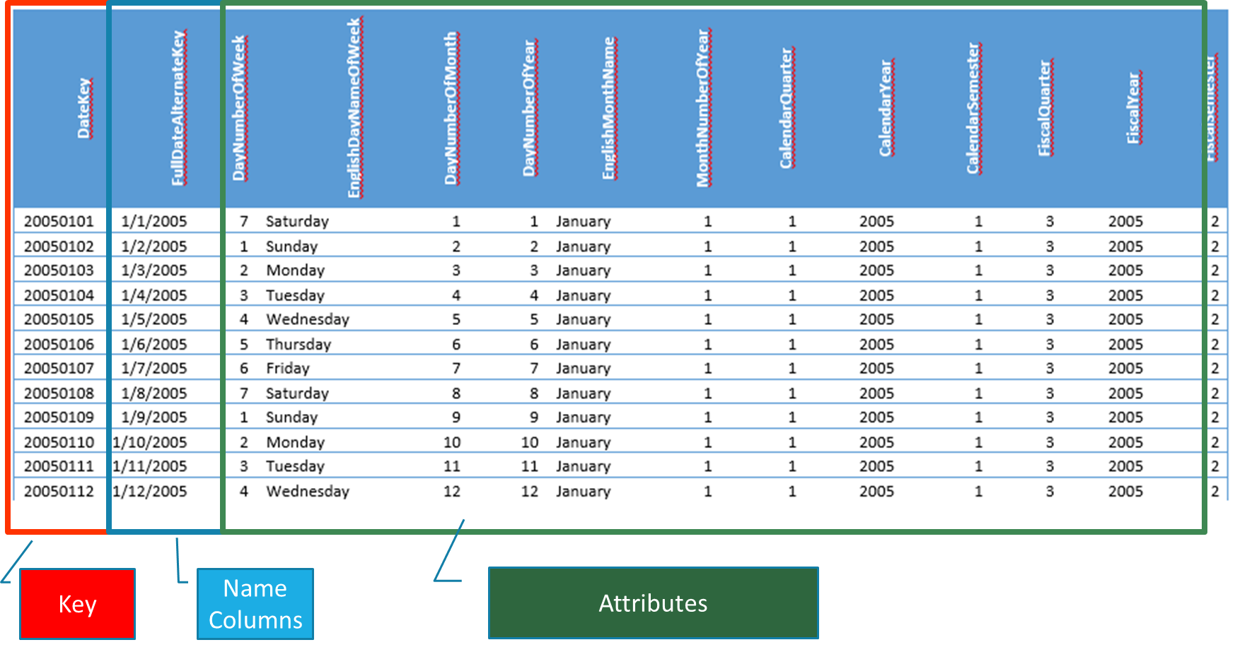
Designing Dimensions

Slide 52
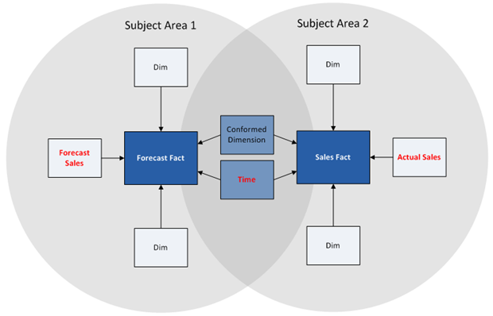
Designing Dimensions
Conformed dimension

Slide 53
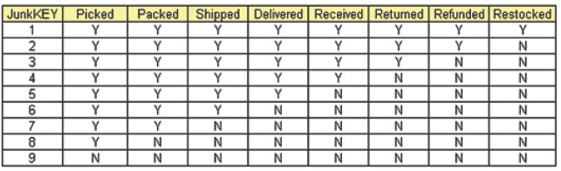
Designing Dimensions
Junk dimension

Slide 54
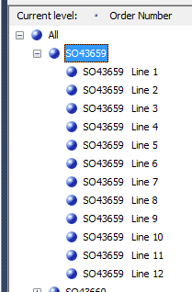
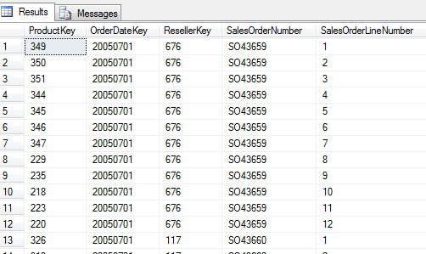
Designing Dimensions
Degenerate dimension

Slide 55
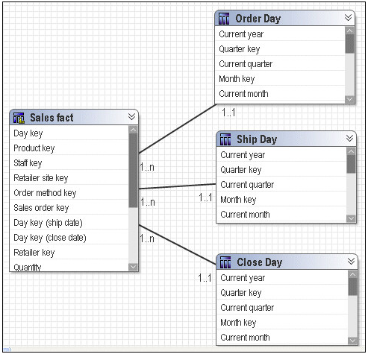
Designing Dimensions
Role-playing dimension

Slide 56
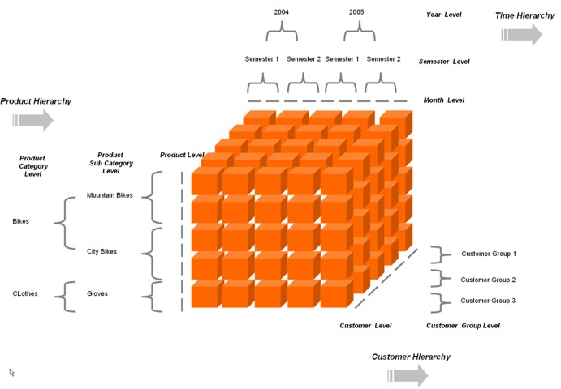
Designing and Implementing a Data Warehouse
Hierarchies

Slide 57
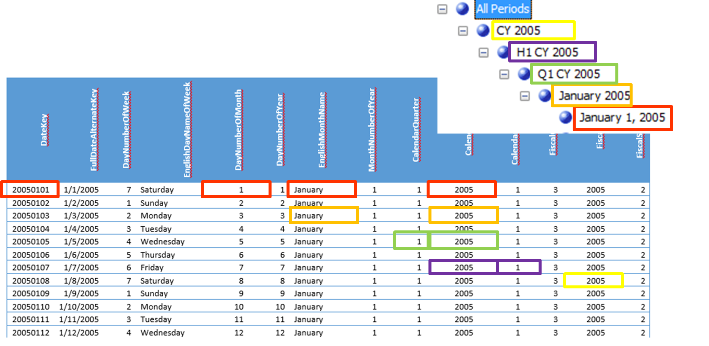
Designing Dimensions
Hierarchies

Slide 58
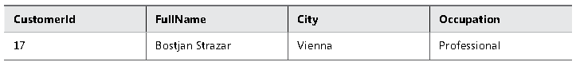
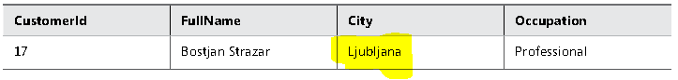
Designing Dimensions
Slowly Changing Dimension (SCD) Type 1

Slide 59
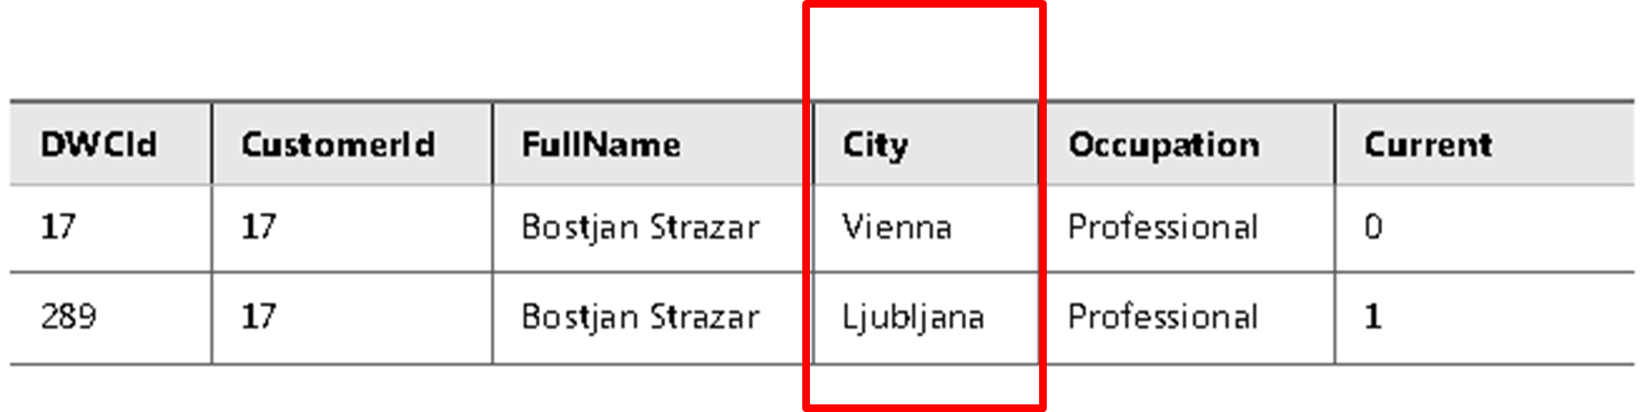
Designing Dimensions
Slowly Changing Dimension (SCD) Type 2

Slide 60
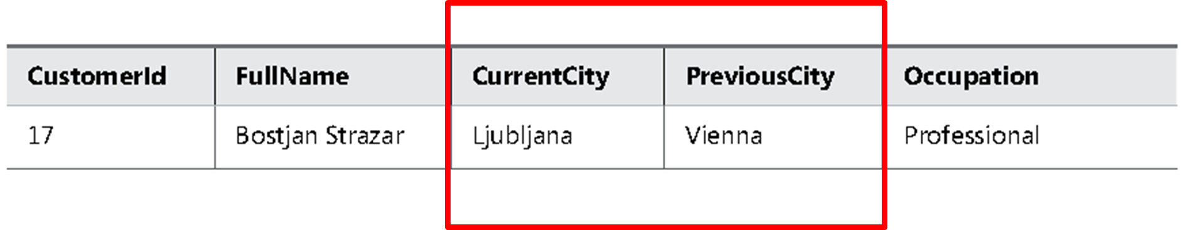
Designing Dimensions
Slowly Changing Dimension (SCD) Type 3

Slide 61
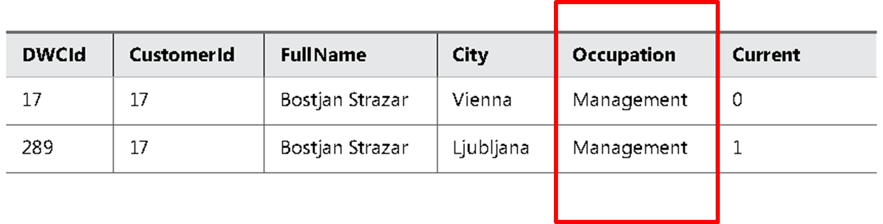
Designing Dimensions
SCD Types Mixture

Slide 62
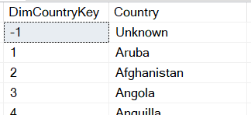
Designing Dimensions
Dummy Records

Slide 63
Designing Fact Tables

Slide 64
Designing Fact Tables
Fact Table Column Types
Foreign keys
Measures
Lineage columns
Business key columns from the primary source table (optional)

Slide 65
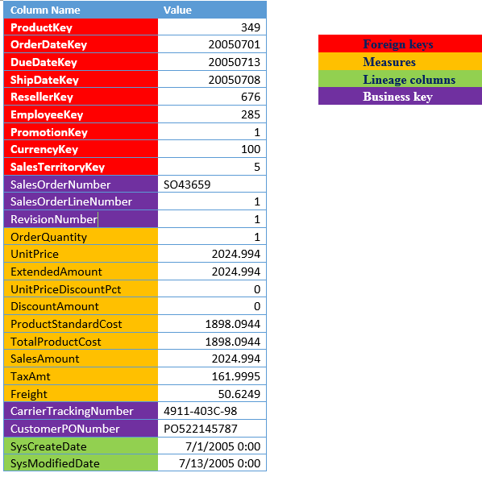
Designing Fact Tables
Fact Table Example
FactResellerSales

Slide 66
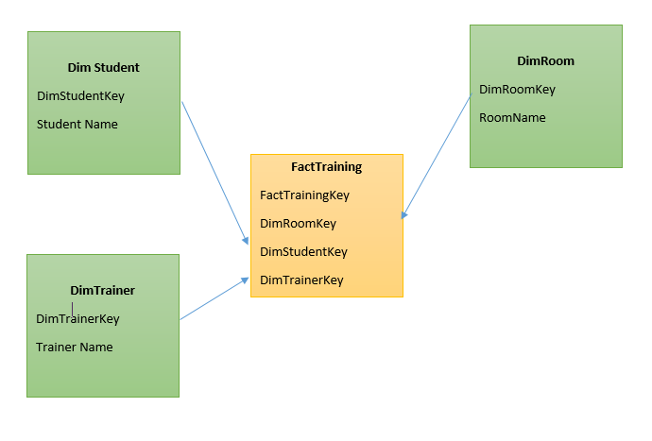
Designing Fact Tables
Factless Fact Table

Slide 67
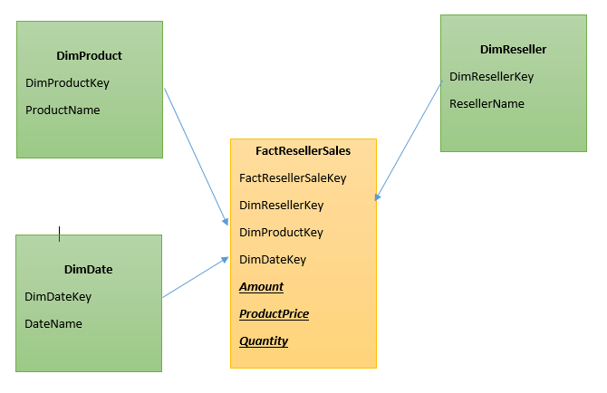
Designing Fact Tables
Transaction Fact Tables

Slide 68
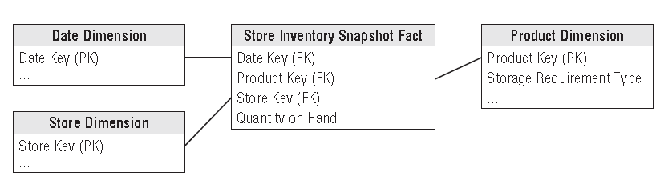
Designing Fact Tables
Periodic Snapshot Fact Tables

Slide 69
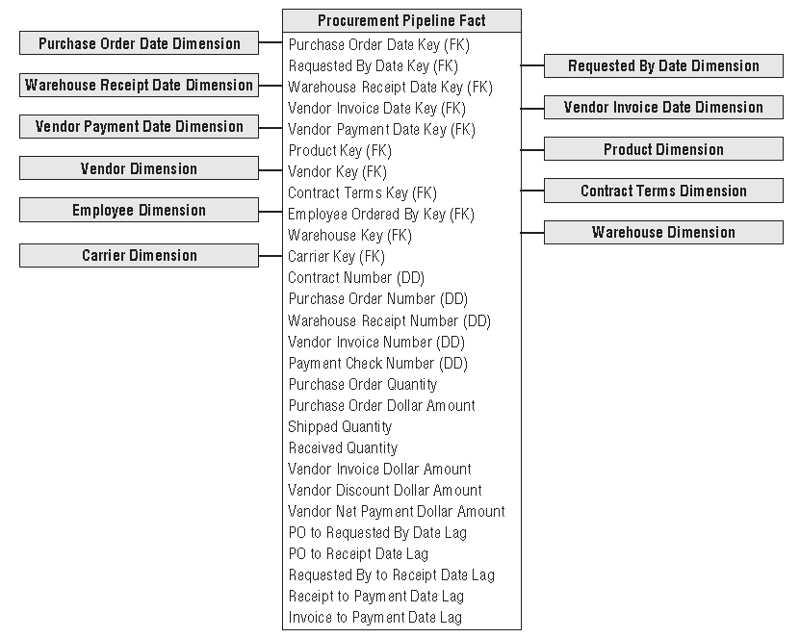
Designing Fact Tables
Accumulating Snapshot Fact Tables

Slide 70
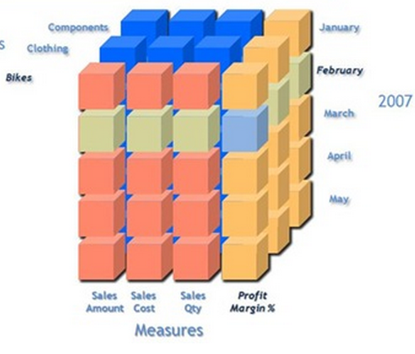
Designing Fact Tables
Measures
Additive measures
Transaction amount
Semi-Additive measures
Account balance
Non-additive measures
Price
Notes:
Let us begin with the definition of each which will be followed by examples: 1. Additive measures: These are those specific class of fact measures which can be aggreagated across all dimension and their hieracchy 2. Semi-Additive measures: These are those specific class of fact measures which can be aggreagated across all dimension and their hieracchy except the time dimension 3. Non-additive measures: These are those specific class of fact measures which cannot be aggreagated across all/any dimension and their hieracchy
A good example of a non aggregatable measure might be 'Price' on a sales record. For example: A) We have sales figures...one may tend to add sales across all quareters to avail the yearly sales..hence this is an example of Additive measure B) We have stock levels say 1000(qty of Item A) on Monday...I sell 200(qty of Item A) on Tuesday I further sell 300(qty of Item A) on Wednesday...going by basic math On Thursday I should be left with 500(qty of Item A, assuming no inventory has flown in) to obtain current stock level I cannot aggregate the Stock sales across time dimension hierarchy...If done I will have inappropriate outcomes C) Aggregation of percentage or dates is an Ideal example of non-additive measures.
Additivity of measures is not exactly a data warehouse design problem. However, you should
consider which aggregate functions you will use in reports for which measures, and which aggregate
functions you will use when aggregating over which dimension.
The simplest types of measures are those that can be aggregated with the SUM aggregate
function across all dimensions, such as amounts or quantities. For example, if sales for product
A were $200.00 and sales for product B were $150.00, then the total of the sales was $350.00.
If yesterday’s sales were $100.00 and sales for the day before yesterday were $130.00, then
the total sales amounted to $230.00. Measures that can be summarized across all dimensions
are called additive measures.
Some measures are not additive over any dimension. Examples include prices and percentages,
such as a discount percentage. Typically, you use the AVERAGE aggregate function for
such measures, or you do not aggregate them at all. Such measures are called non-additive
measures. Often, you can sum additive measures and then calculate non-additive measures
from the additive aggregations. For example, you can calculate the sum of sales amount and
then divide that value by the sum of the order quantity to get the average price. On higher

Slide 71
Practical Task

Slide 72
Practical Task

Slide 73
Q&A Session

